Slide 1
Project Development Workflow
Using Git, GitHub, and SourceTree

Slide 2
Best Practices
Remote branch should never be broken
You should always have full confidence that deploying to the remote won’t break anything
Develop features and bug fixes in side branches
Try to reduce / avoid simultaneous editing
Careful task assignment
Team communication

Slide 3
Your View of the Project
v 3.0
v 2.0
v 1.0
initial
abc01
master
origin/master
stable

Slide 4
Your Daily Routine (1) (Minor / Safe Modifications)
Fetch and pull from remote*
Make, stage, and commit changes
Fetch and pull again (only when necessary)*
Push to remote
* resolve potential conflicts

Slide 5
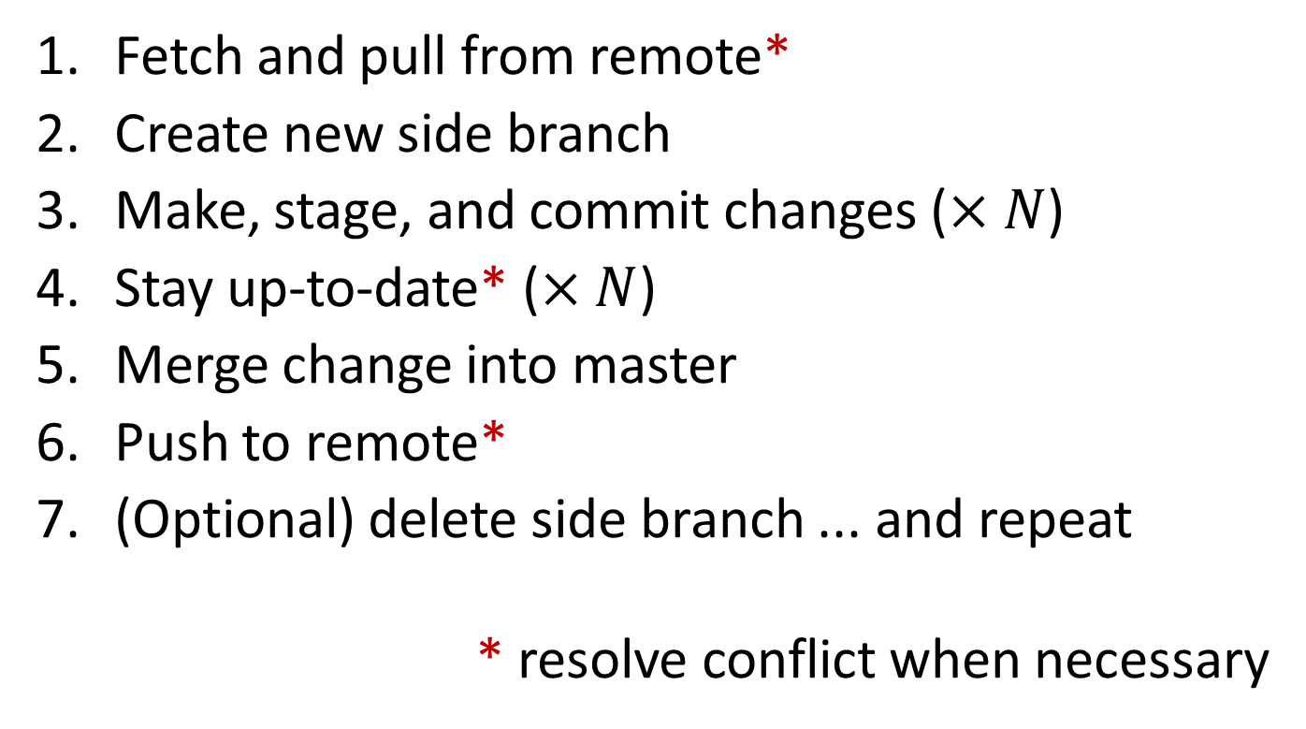
Your Daily Routine (2) (Major / Risky Developments)
Fetch and pull from remote*
Create new side branch
Make, stage, and commit changes ($×N$)
Stay up-to-date* ($×N$)
Merge change into master
Push to remote*
(Optional) delete side branch ... and repeat
* resolve conflict when necessary

Slide 6
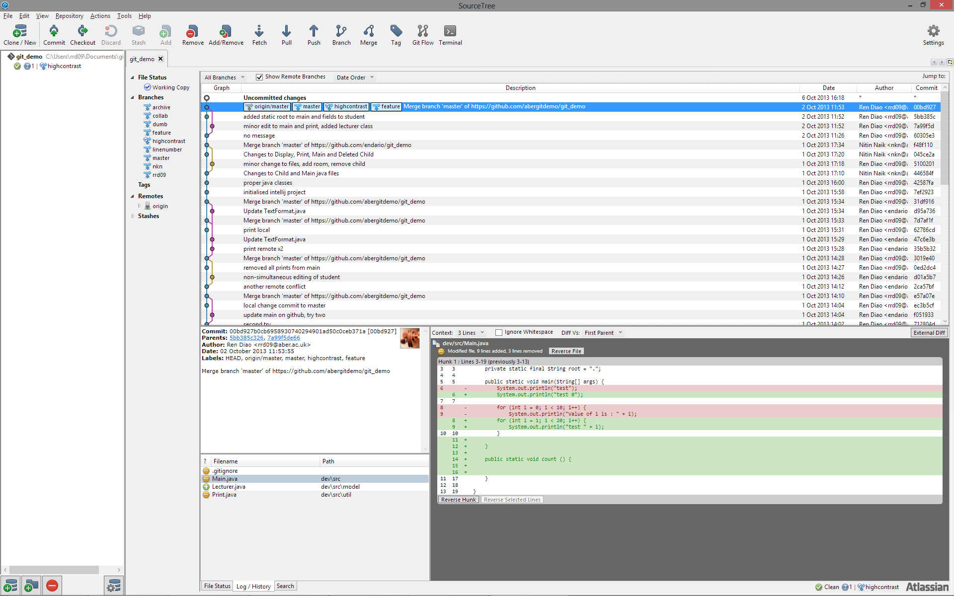
SourceTree Interface

Slide 7
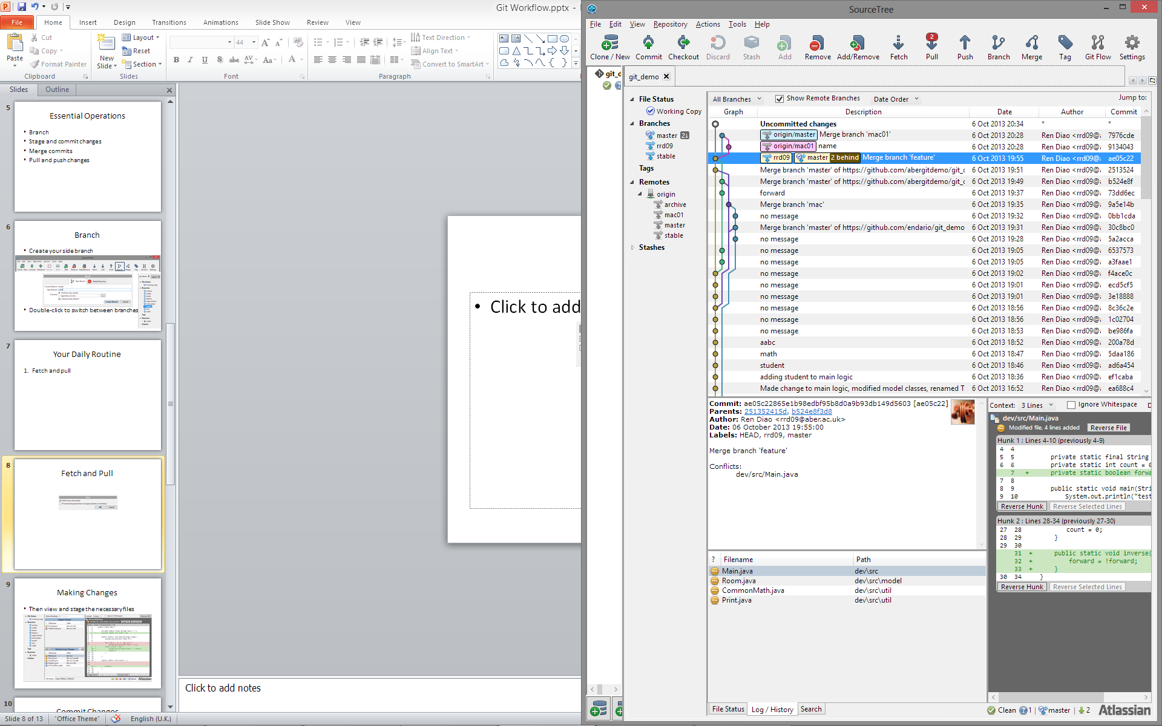
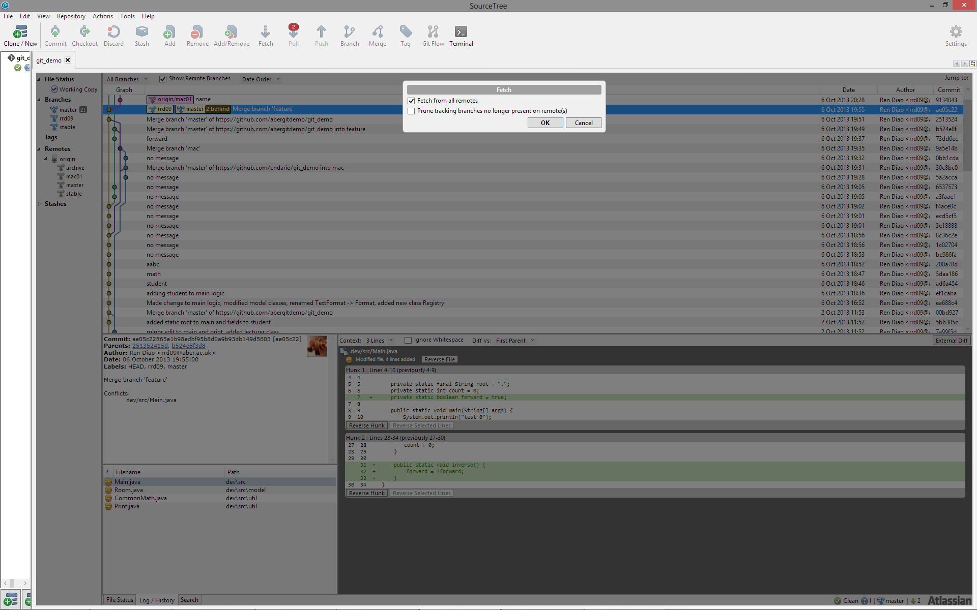
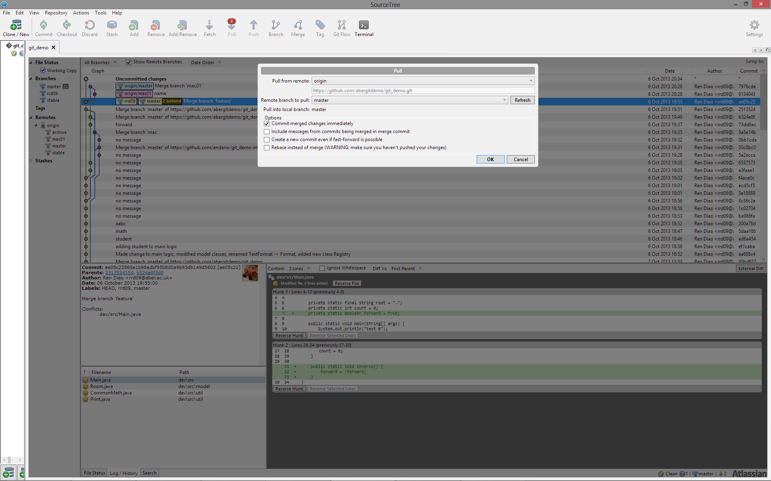
1. Fetch and Pull* (update master)
Switch to master (if not already on)

Slide 8
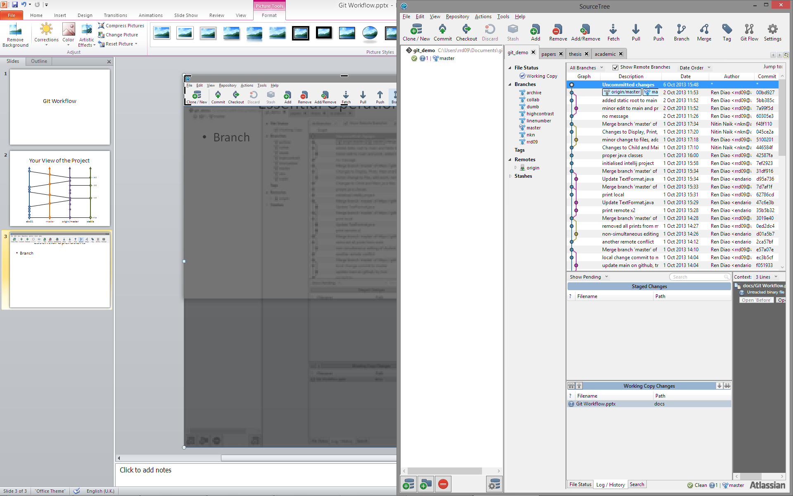
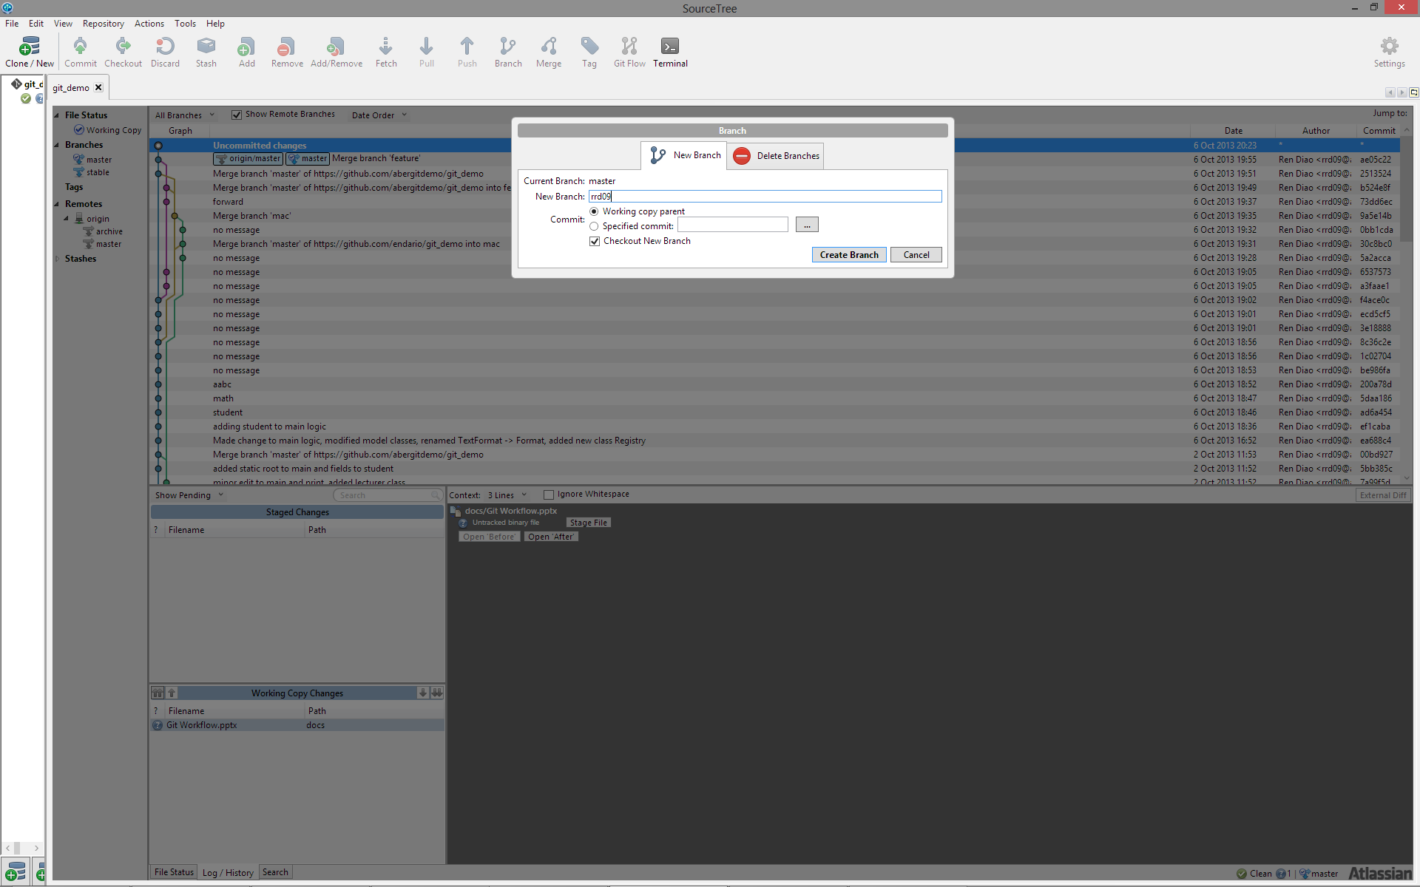
2. Create New Side Branch
Create (and switch to) a new side branch

Slide 9

3(a). Make Changes
None of Git’s business

Slide 10
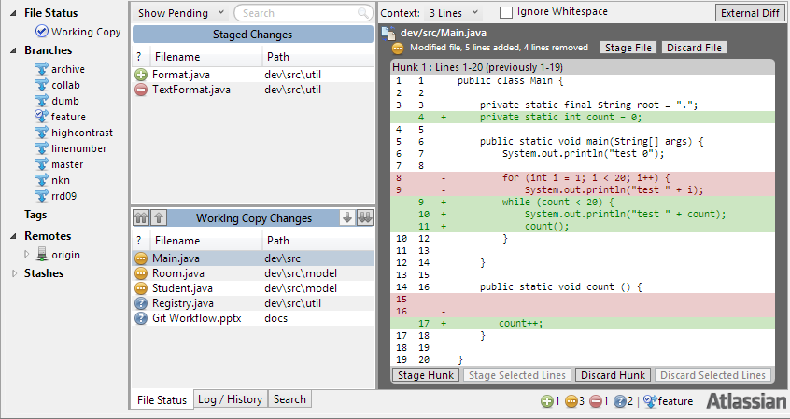
3(b). Stage Changes
Remember only stage the necessary changes

Slide 11
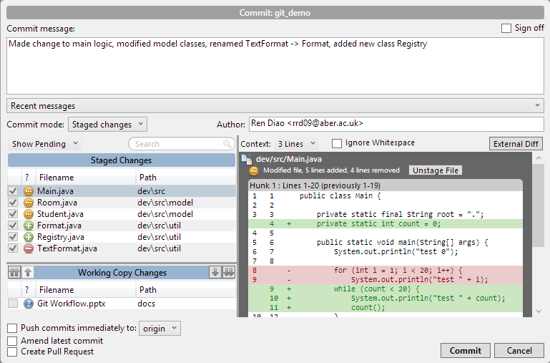
3(c).Commit Changes

Slide 12
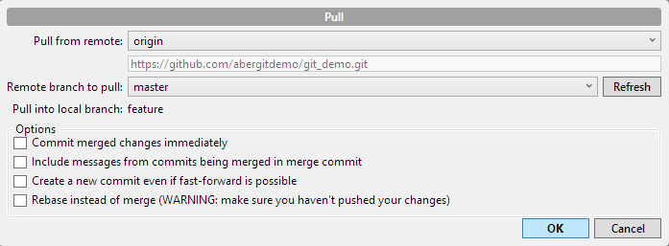
4. Keeping Up-to-Date* (while in a side branch)
Fetch & Pull origin/master into your branch
and resolve conflicts ... when necessary

Slide 13
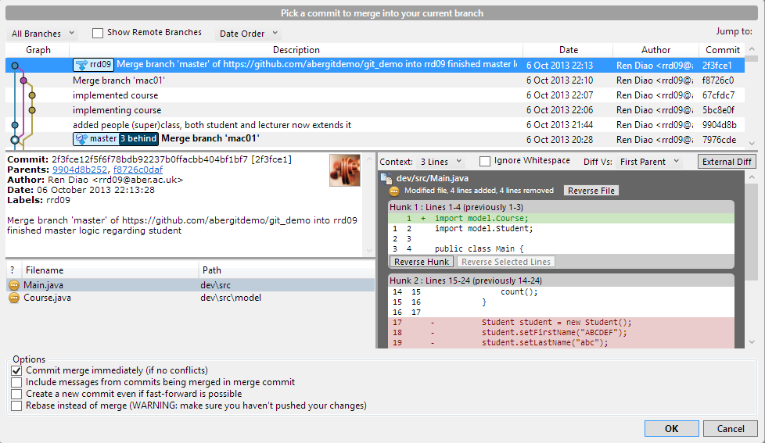
5. Merge Change into master (remember to switch to master first)
Switch to master branch

Slide 14
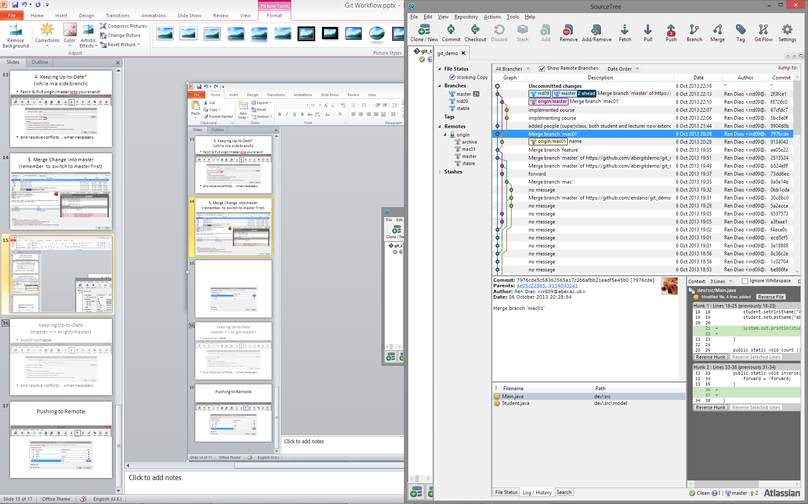
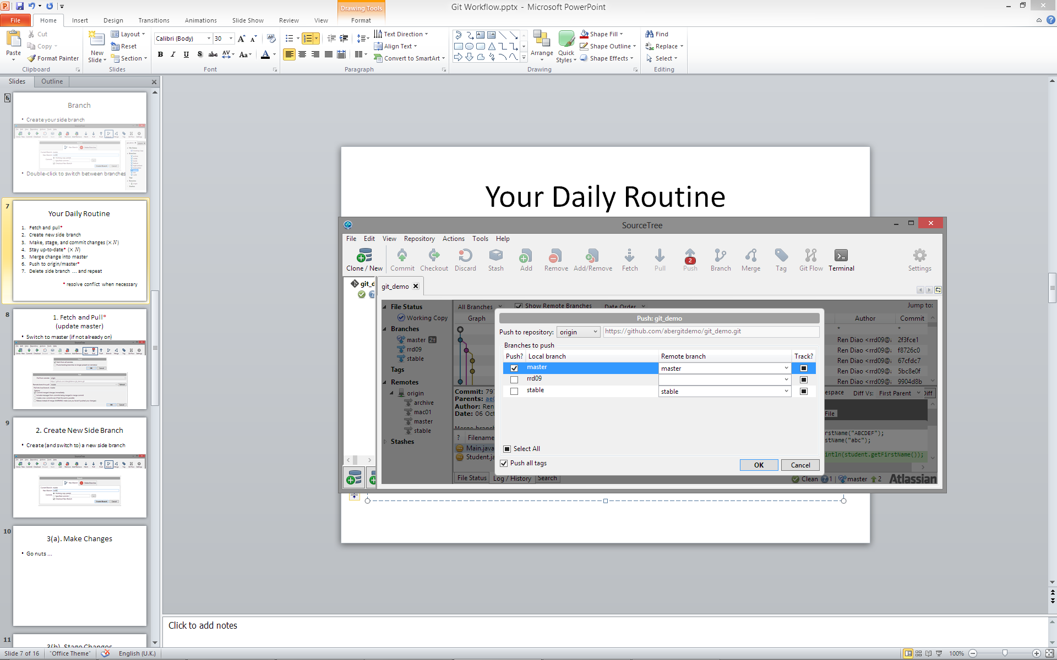
6. Push to origin/master*
If someone happens to push updates in between your steps 4 and 6, you may need to Pull again and deal with the potential merge conflicts

Slide 15
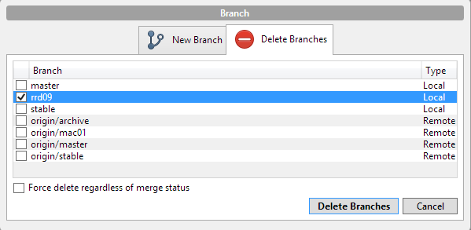
7. Delete side branch ... and repeat
Delete your local side branch if this particular line of development is completed
Rinse and repeat

Slide 16
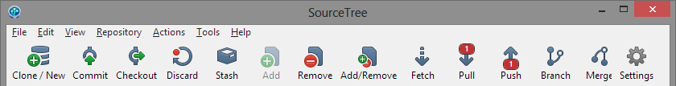
* Deal with Merge Conflicts
When can it happen?
Pull remote changes into side branch
Merge side branch into master
Push master to remote
Inconsistency caused by simultaneous editing of the same part of the code / file
Try your best to resolve all conflicts, especially when dealing with the remote branch

Slide 17
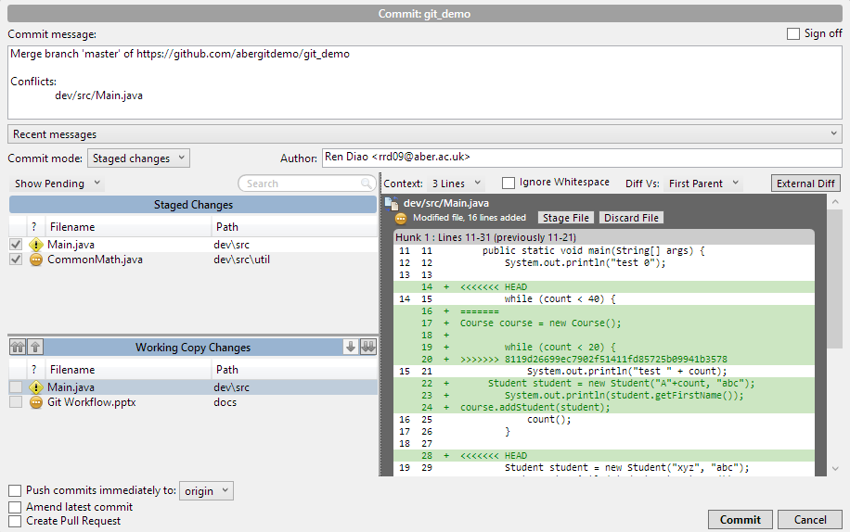
* View Conflicts in Diff Panel

Slide 18
* Resolve Conflicts
Use any text editor / IDE to correct the code
Remove all tags like
<<<<<<< HEAD
=======
>>>>>>> 8119d26699ec7902f51411fd85725b099
Make sure it compiles and runs
and/or logically correct!

Slide 19
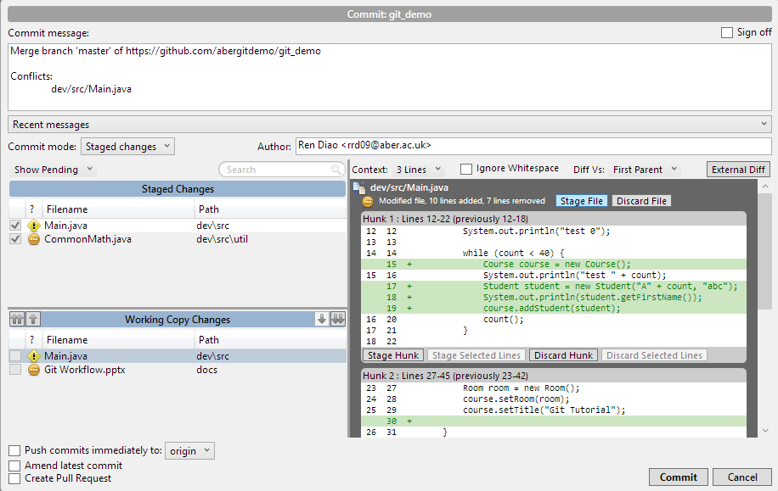
* Re-Stage and Commit

Slide 20
Essential Operations
Branch
Stage and commit changes
Merge commits
Pull and push changes

Slide 21
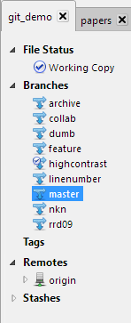
Branch
Create your side branch
Double-click to switch between branches

Slide 22
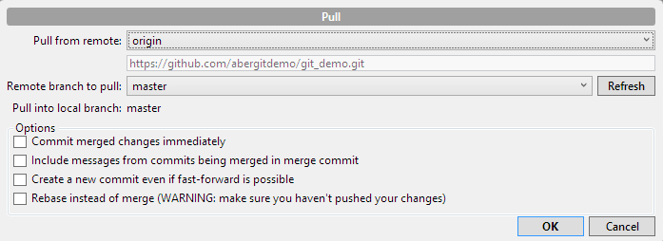
Keeping Up-to-Date (master <-> origin/master)
switch to master
and resolve conflicts ... when necessary

